Slide 1
IST687 Final Project
Agile Kanban Methodology
ADS Group 4
Jacob Dineen
Mason David
Mohamed Khalifa
Zhaowei Jiang
Kellie Mosely

Slide 2
Team Page
Trello Link
Main Board:
https://trello.com/b/lXdbFrjQ/

Slide 3
Introduction
As consultants, we have been propositioned with the task of better understanding, analyzing and predicting net promoter score as it relates to our client’s business. “Net Promoter Score®, or NPS®, measures customer experience and predicts business growth. This proven metric transformed the business world and now provides the core measurement for customer experience management programs the world round” (netpromoter.com). By assigning a value to each individual consumer's experience with our brands, we can put ourselves in a better position to meet not only their goals, but our goals, as a company, as well.

Slide 4
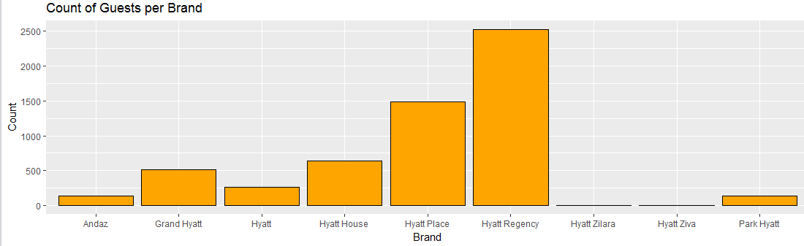
Our Client
Our client is Hyatt, and the following chains of the Hyatt brand are the acting filter for our analysis: Hyatt Regency, Hyatt Place, Hyatt House, Hyatt and Andaz. Almost 80% of the dataset that we analyze will be inclusive of customers who stayed at either a Hyatt Regency or Hyatt Place location, so while our analysis can carry over to other branches within these regions, it would be most relevant as it pertains to renderings of these specific brands.

Slide 5
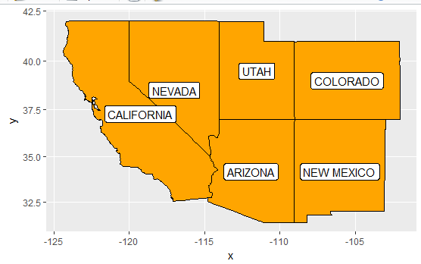
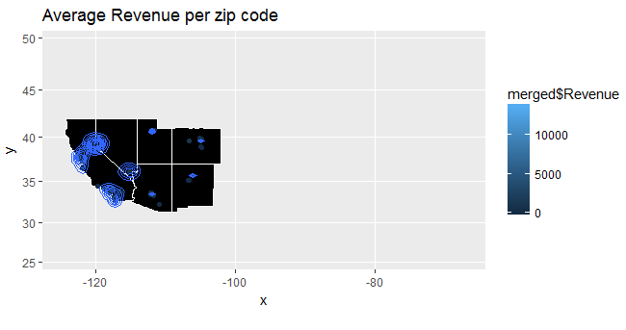
Target Region
Our focus, as consultants, is to look at the Southwest/Western United States. Because the survey response rate is too low, we will want an expanded geographical sample to better represent the population as a whole. Our goal is to run a statistical process a large number of times, and we will take the law of large numbers into account. According to the law, we expect to see the distribution of sampling means starts to create a bell-shaped or normal distribution, and the center of that distribution, the mean of all of those sample means get really close to the actual population mean.

Slide 6
Business Questions
What’s our target region?
Is there a relationship between audience demographics/behavior and NPS?
What specific criteria “amenities” contribute to higher NPS?
What recommendations can we provide to our clients to maximize the overall NPS?

Slide 7
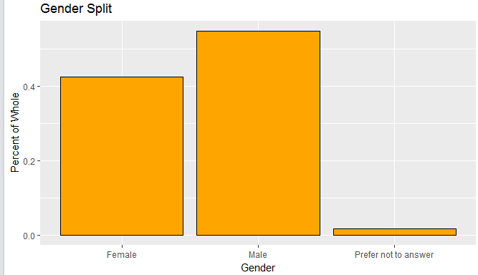
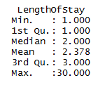
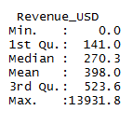
Behavioral And Demographic Analysis
Summary statistics on our data to this point, which contains 5713 total survey responses aggregated across the Southwestern United States, will provide us with notable trends, be they behavioral or demographic, about our current audience. This information won’t necessarily help with increasing NPS Score, but it will aid in potential marketing efforts if we are more targeted in gearing campaigns towards specific clusters of the population.

Slide 8
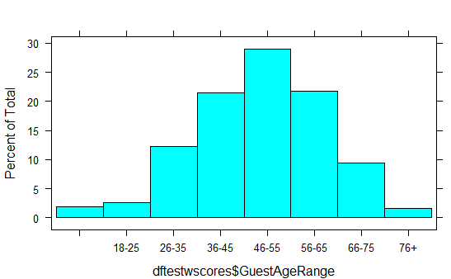
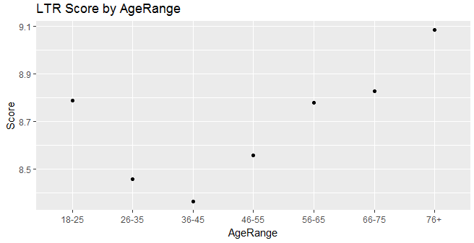
Behavioral And Demographic Analysis
Reason for visit : Of the 5713 observations, we have a pretty even split between people staying at our hotels for reasons pertaining to either business and leisure.
Guest Country: 92% of our survey respondents were visiting from somewhere in the United States. This is either telling us that there is an international market to be tapped into, or we should simply focus on regionality.
Guest Gender: Our visitors, as it relates to our sampled data, skews slightly male - as they represent 55% of our total survey respondents.
Guest Age Range: Of our survey respondents, this is likely one of our most significant pieces of data as it relates to audience demographics. We skew supremely heavy towards an older audience, which could speak to a number of things. 1. There could be some auto-correlation between age and willingness to respond to a survey. 2. There could be external economic class differentiators, as it relates to age, ie. income/financial stability.
Guest Language: 5600 of our 5713 observations of survey respondents registered English as their language. This could potentially be a sampling error where we might not have sent out bilingual or spanish surveys, and as such, our response rate was low amongst that demographic.
Our mean revenue generated by each of our observations was $398.00 per their respective stays, while our mean visit length was 2 days - Our quantile statistics on the customer's’ length of stay shows us that the 25%-75% is 1 to 3 days.
Males spend, on the average, about 15% more than females. The 18-25 Age demo spends the least, on average, and the 26-65 range is our sweet spot in terms of average revenue generated.

Slide 9
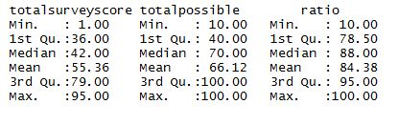
The Survey
One of these reasons we wanted to create a ratio column on the survey score against the total possible score is due to all of the null values present within those particular columns. This information may help those in charge better understand the audience that responds to surveys. The way to read the table below is that, on average, only 66% of the survey questions were responded to.

Slide 10
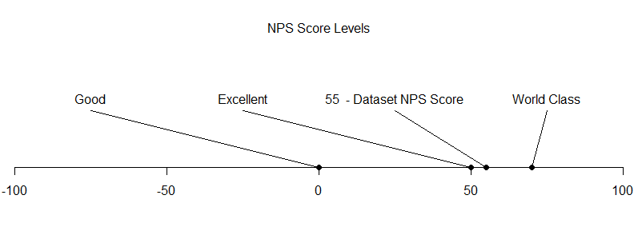
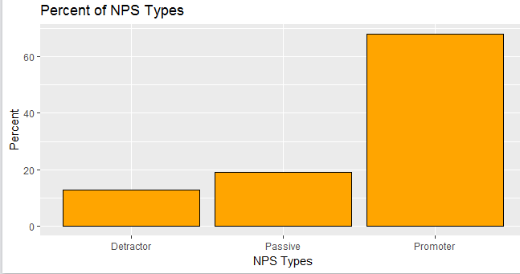

NPS Score
The total NPS Score for our data in question is determined by summing up the total count of responses rendered within the NPSType column. We secure counts for each of the three iterations of response types; Promoters, Detractors and Passives. We then calculate the percentage share of each of these response types. Passives do not play a role in our NPS Score other than representing part of the whole, so we focus on the percentage of Promoters of the whole against the percentage of Detractors of the whole- It is still important to include ‘Passive’ respondents as part of the total, aggregate grouping of respondents so we don’t distort the final result.. Upon subtracting these numbers and scaling into a whole number, we receive our true NPS Score.
In the instance of our particular dataset, we see that there is a final NPS score of 55.1024. “Based on the global NPS standards, any score above 0 would be considered “good” (50 and above being excellent while 70 and above is considered “world class”)” (Promoter.io).

Slide 11
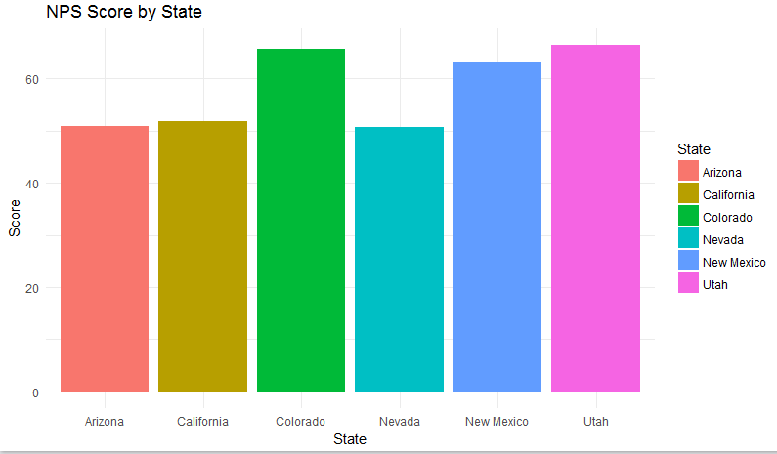
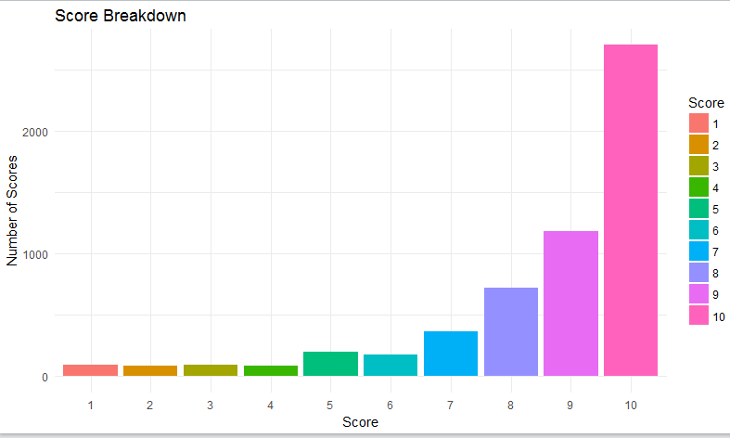
NPS Score

Slide 12
Recommendation
We have a number of recommendations as it relates to our research on this particular data set, although it should first be noted that we are simply looking at one month’s worth of data, during a single year, with a geographical filter layered on top of that. Our first recommendation would be as it relates to marketing, and the audience that we are trying to either lure in through conquesting efforts directed at our competitors, or brand loyalist efforts to retain our existing customer base. If the former, we need to focus on the segments of the population that don’t currently represent a normal distribution of our sample. That could either reference a younger demographic, or potentially a foreign, international market that sees substantial air traffic to the Western United States. If, instead, we wanted to take the data we have and launch targeted advertising campaigns to prospective consumers that represent a majority of our total revenue, and a majority of our ‘Promoters’, then we could take a look at some of the summary statistics noted above. There isn’t 100% accuracy levels when predicting human behavior, so even if we were to target attributes, whether they be behavioral or economical, representative of our desired NPS Type, there could still be external factors that influence true satisfaction.
To start, we conducted a multiple regression analysis on different sets of variables that we wanted to observe in relation to one another. “Multiple linear regression attempts to model the relationship between two or more explanatory variables and a response variable by fitting a linear equation to observed data. Every value of the independent variable x is associated with a value of the dependent variable y” (stat.yale.edu) Our Likelihood to Recommend column will always be our dependent variable, or our Y variable, so we measured a series of audience segments, survey responses, and hotel amenities against that score. What we found was that the only real relationship between variables was seen when looking at the survey response data. Not all of the ratings were deemed significant in causing variance in the Likelihood To Recommend score however. Of the 10 ‘survey questions’, only the results of 5 proved to move the needle. Overall Satisfaction, Guest Room Rating, Customer Service, Staff Cared and Hotel Condition, in that order, were deemed the most integral part of the consumer experience. All subjective measures, but insightful nonetheless. Overall Satisfaction is closely linked with experience, which is defined by friendliness, and tidiness. Implementing a bottom-up business model would a transformative solution here. “If employees are happy, satisfied, dedicated, and energetic, they'll take real good care of the customers. When the customers are happy, they come back. And that makes the shareholders happy” (The Rise of Southwest Airlines). Because our customer’s experience is reflective, at least in part, of their interactions with our hotel staff, implementing this model with increased focus on our employees would lead to better results.
Research was also conducted on the process of surveying guests, and ways to improve efficiency of that process. Of 200,000 GuestID records, we received responses from 2.5% in regards to their stay, which puts us in the lower end - “Response rates can also fall below 2% (about 1 response for every 50 invitations sent) when the respondent population is less-targeted, when contact information is unreliable, or where there is less incentive or little motivation to respond” (Naicu). If the sample were to increase, we would, in turn, reduce our margin of error within our models and increase the statistical relevance of our samples. One way to do this, as noted above, would be to offer incentives for valid survey completions, such as free points for their next booking. Not only does this motivate hotel-goers, but it asks as a loyalist technique to encourage further business with a specific chain. Another issue with the surveys rendered was that every question was on a scale, which makes it difficult to equate actual sentiment. We propose adding text fields into the incentivized surveys to better understand the consumer’s true feelings about their stay. Numerical classification works in scale, but it is challenging to change when you’re aren’t sure what exactly is broken within a process.

